Slide 1
Style Transfer
From A Neural Network Perspective
By 1120203529 武稔隽 2022.07

Slide 2
Contents
Introduction
Mechanism & Network Structure
Results & Analysis

Slide 3
Introduction
The Style Transfer is to combine the content of one image with the style or texture of another image.
The problem thus can be divided into two parts: obtaining the image content & achieving the image style.

Slide 4
Mechanism & Network Structure
Instead of direct comparation between generated images and target images, the naive mechanism is to compare them in the feature space from a neural network.
Content features are simply obtained through some feature layer within the neural network.
Style features are captured by the covariance matrix within certain feature layer.

Slide 5
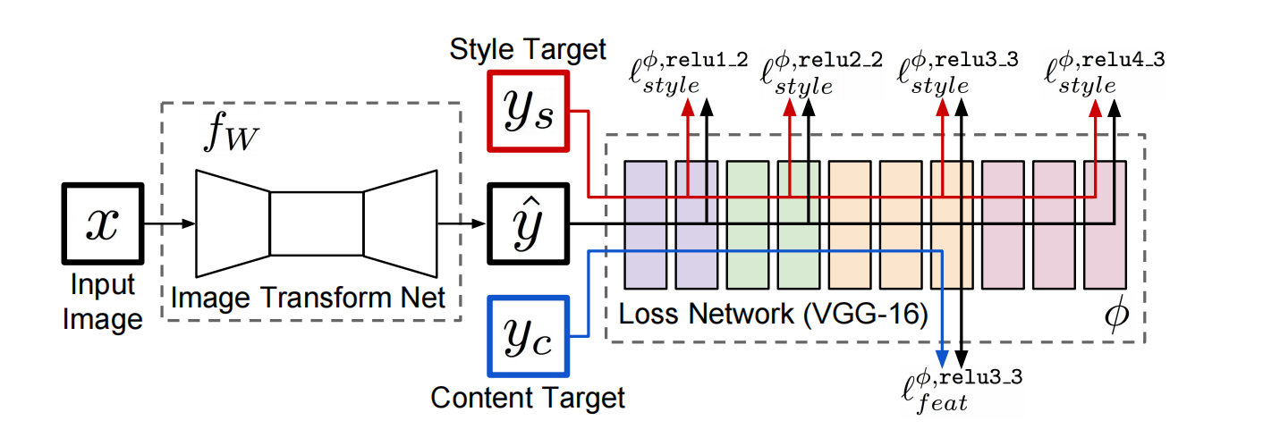
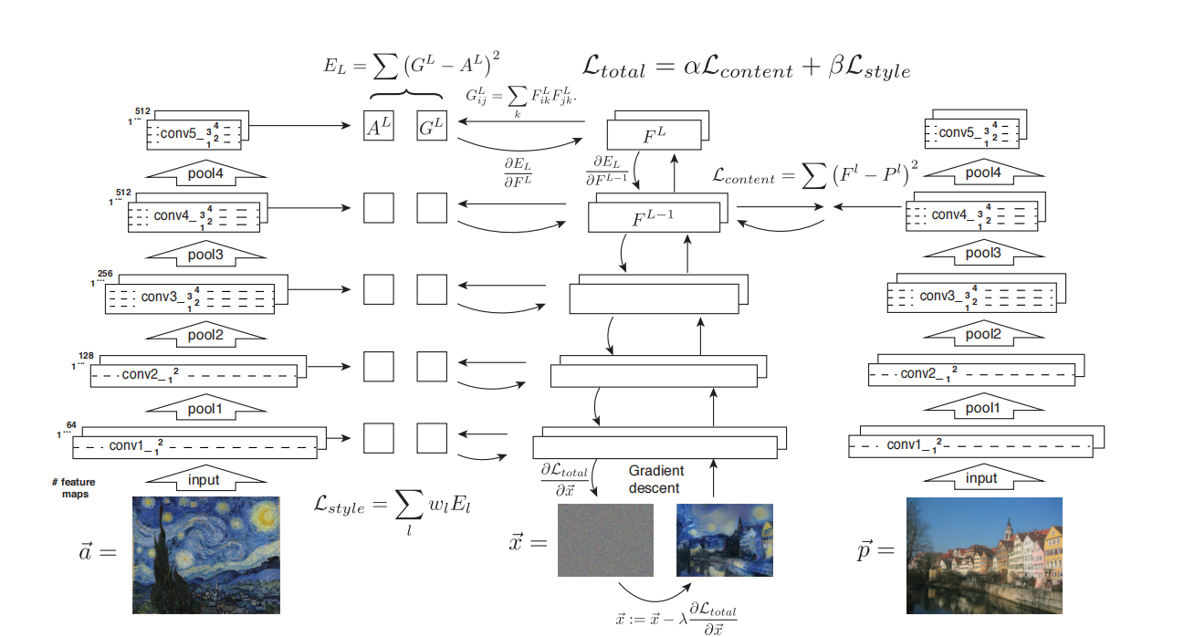
Naïve Network Model

Slide 6
Naïve Network Model
Pretrained on VGG16/VGG19
Both content features and style features are computed from the pretrained network
The expected image is also trained on the pretrained VGG network with its parameters frozen, starting from a white noise image.

Slide 7
Naïve Network Model
Pros:
Easy to understand, Using pretrained models, Obtaining content & style representations from the feature space,…
Cons:
One-time training for One content image and One style image -> Not Flexible
Training at the same time Transferring -> Slow Speed
Generating the images through pixel-level -> No Abstract Information Learnt

Slide 8
Advancement -- Real-time Style Transfer
Training a network for arbitrary content input w.r.t. one style
Compute feature-level loss -> Perceptual Loss
Using faster and better neural network to capture the features of the input content images
More efficient batch normalization -> Instance Normalization

Slide 9
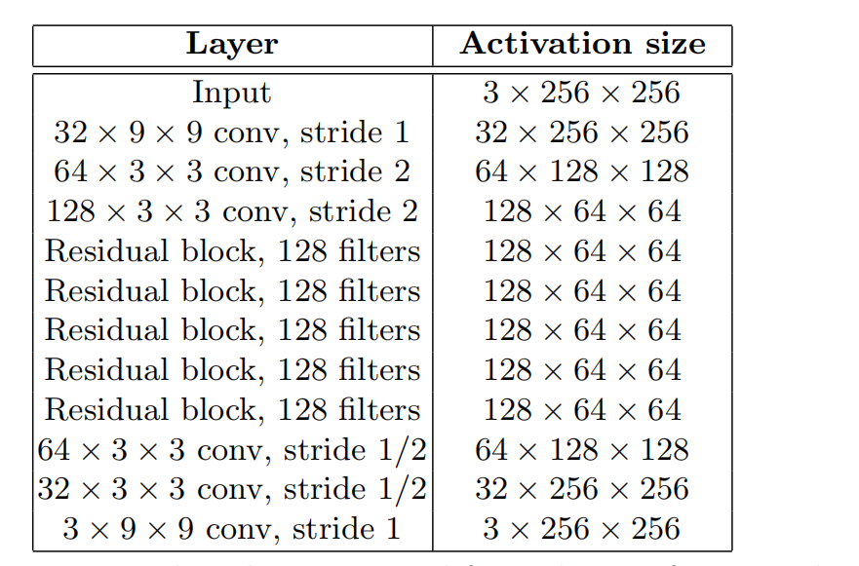
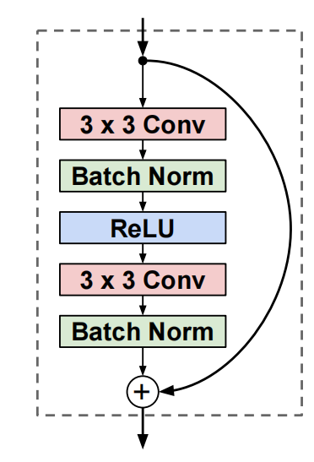
Real-time Style Transfer Model
The TransformNet

Slide 10
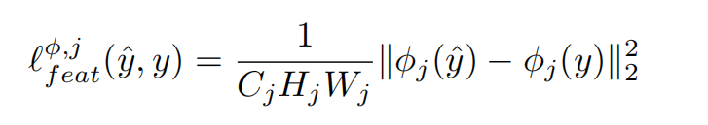
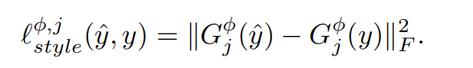
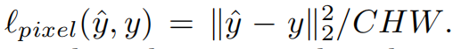
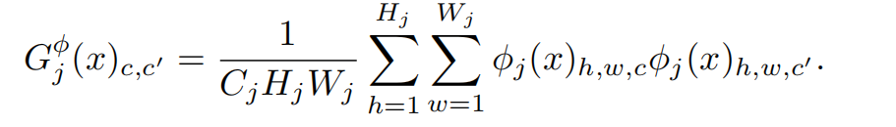
Real-time Style Transfer Model
Perceptual Loss

Slide 11
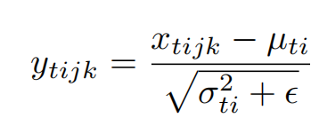
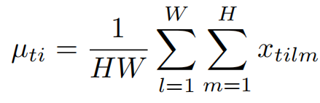
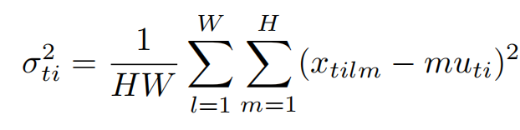
Real-time Style Transfer Model
Instance Normalization

Slide 12
Further Optimization
Instance Normalization

Slide 13

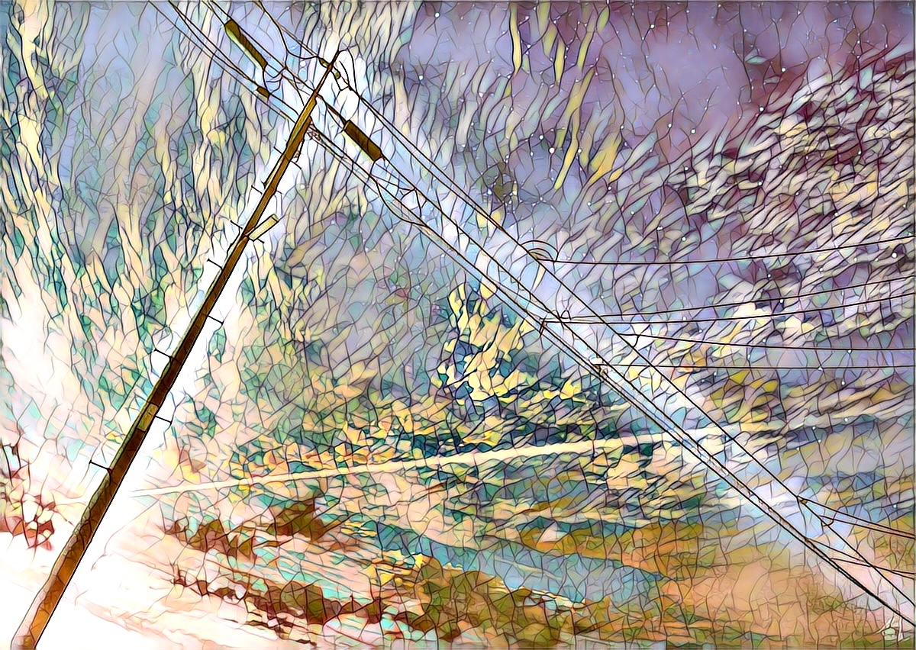
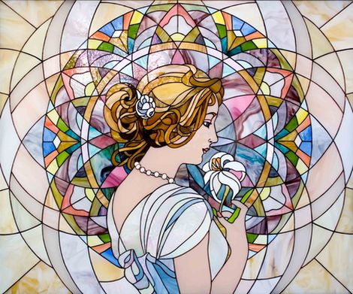
Results

Slide 14

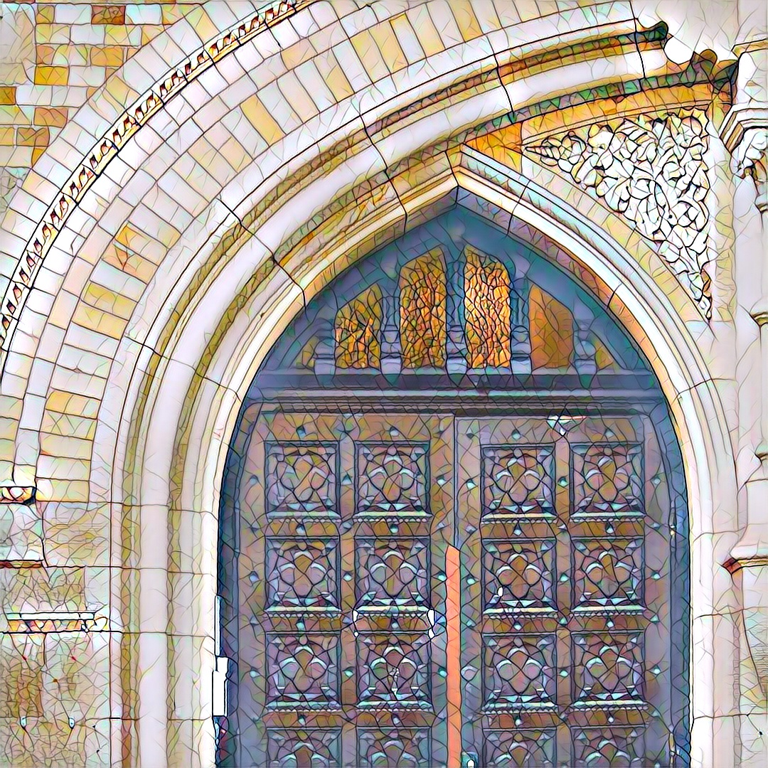

Slide 15
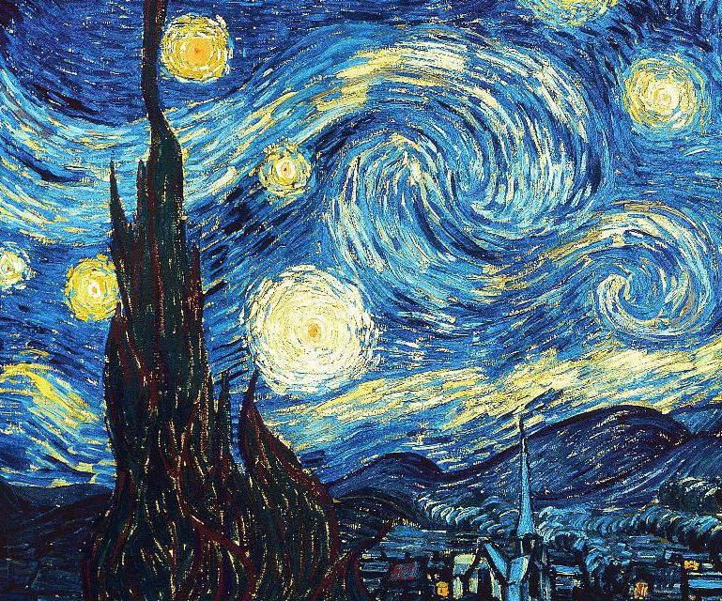
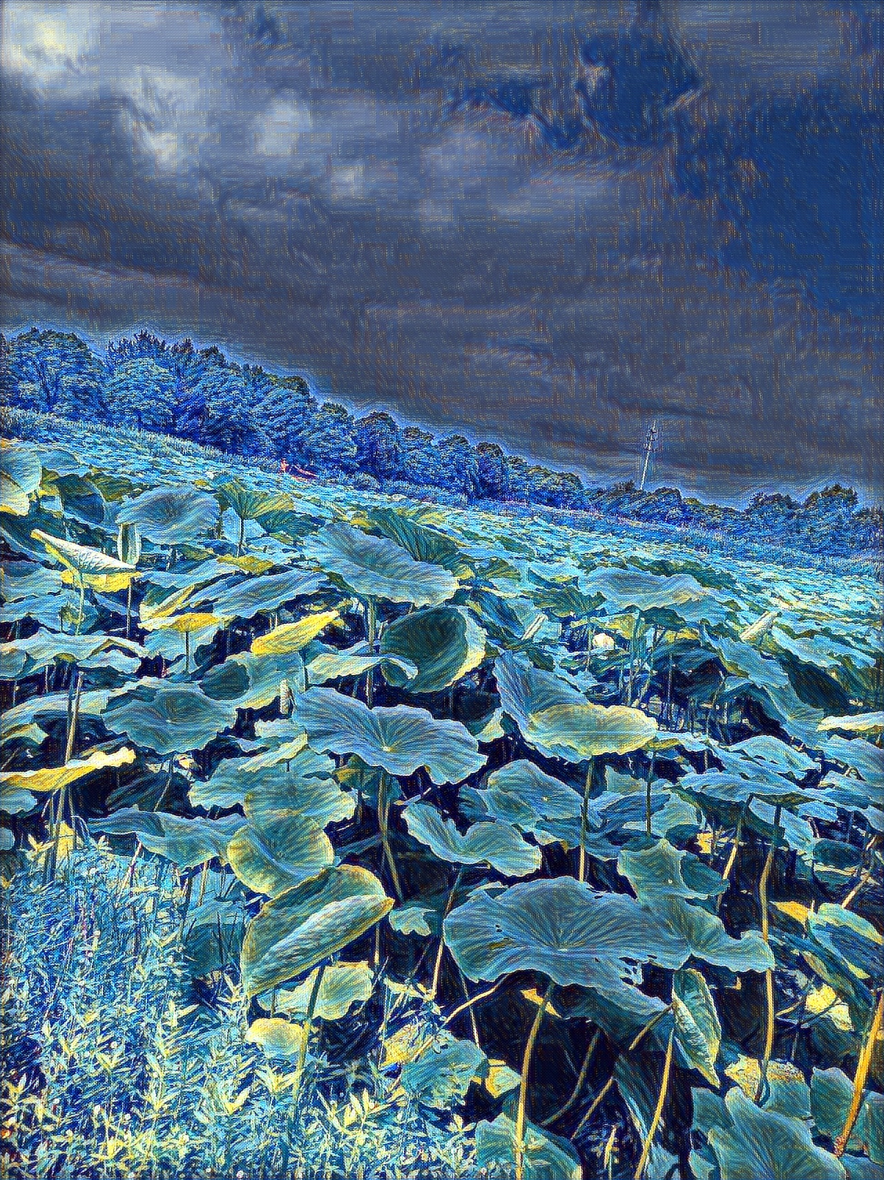
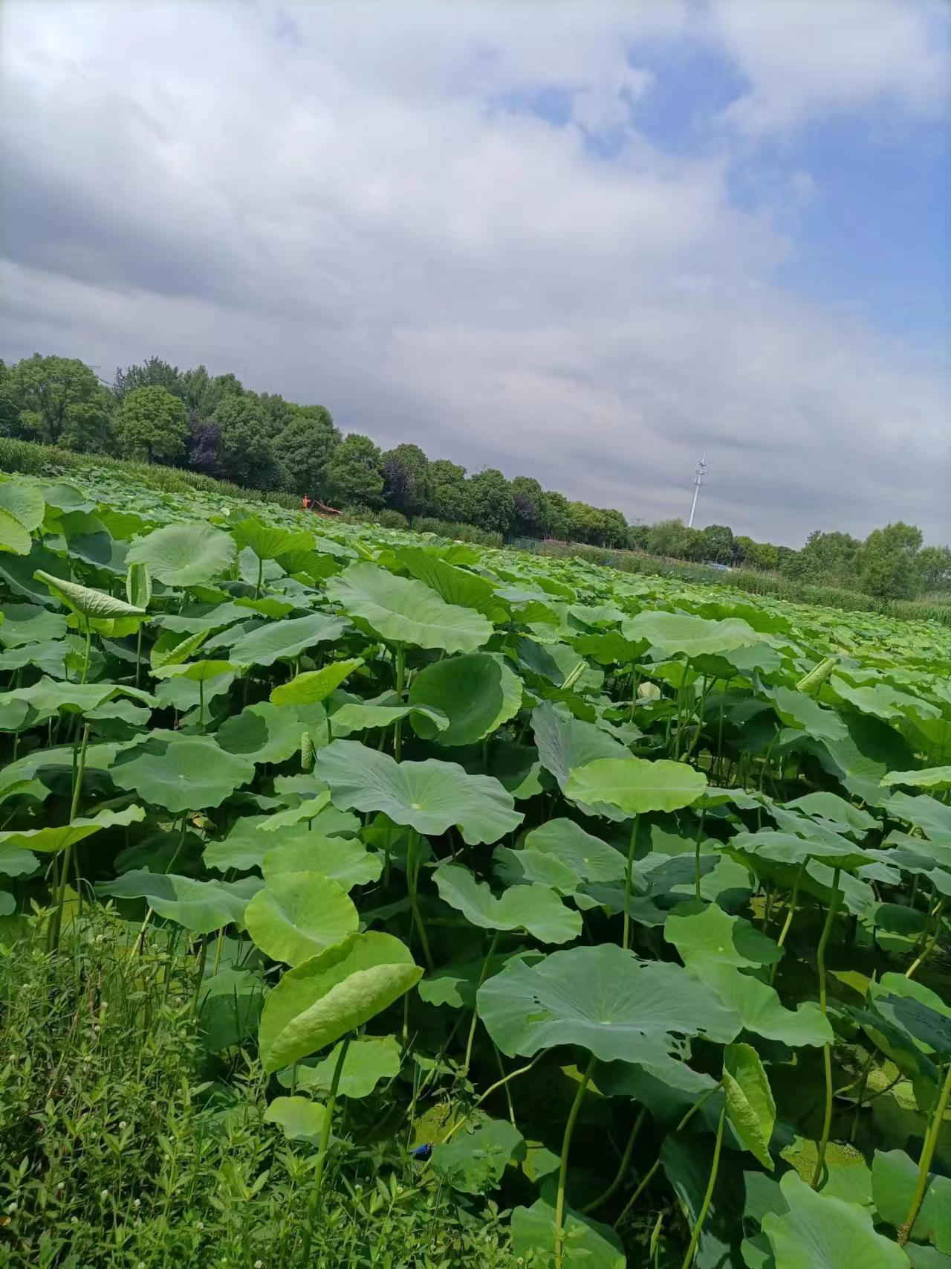

Slide 16
Analysis
Features with relatively smaller sizes tend to focus on more detailed style.
256 x 256 feature map can only transfer some styling details of a 2048 x 2048 (or more) content image
Loss/Training History Visualization
On different machines & With different network structures

Slide 17
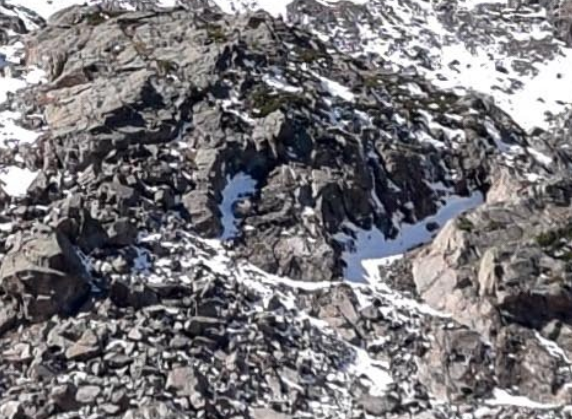

Analysis - Feature Sizes
Content image with large size:

Slide 18
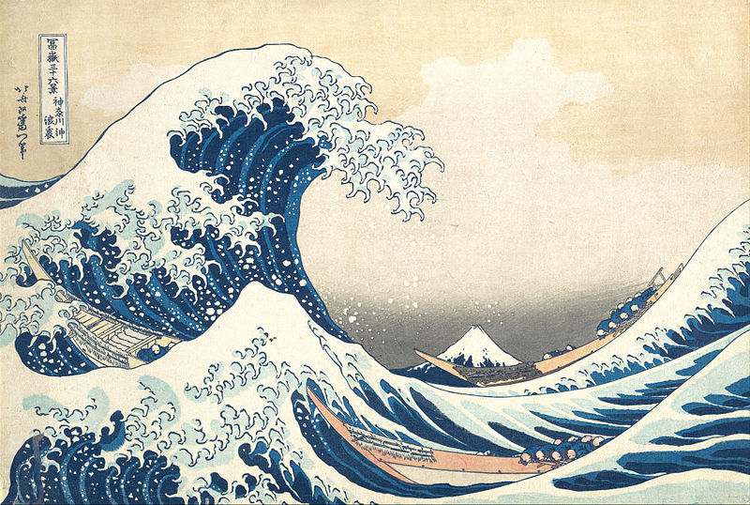
Analysis - Feature Sizes
Style image:

Slide 19
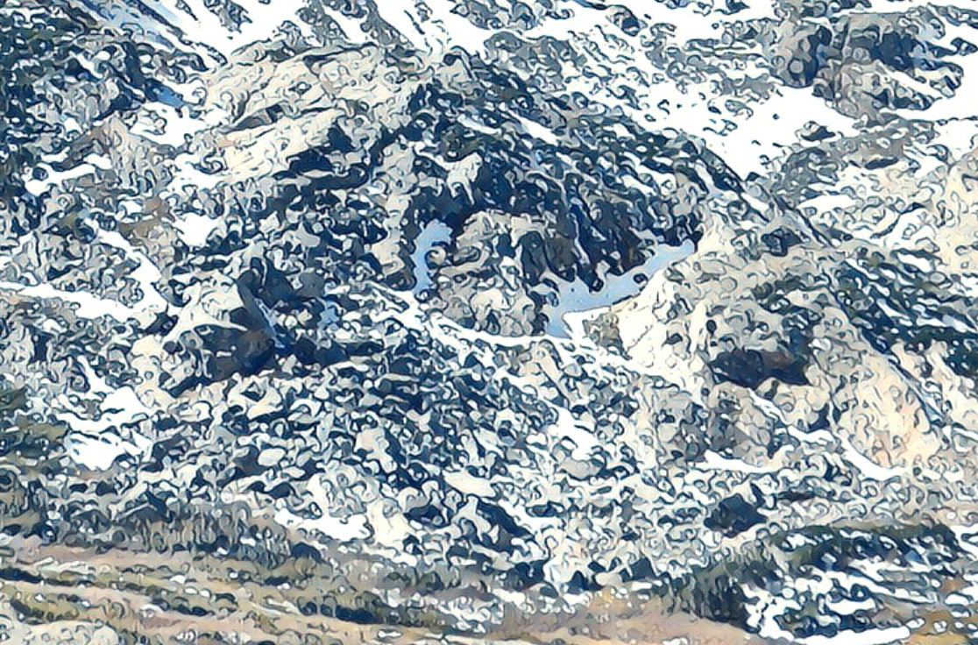
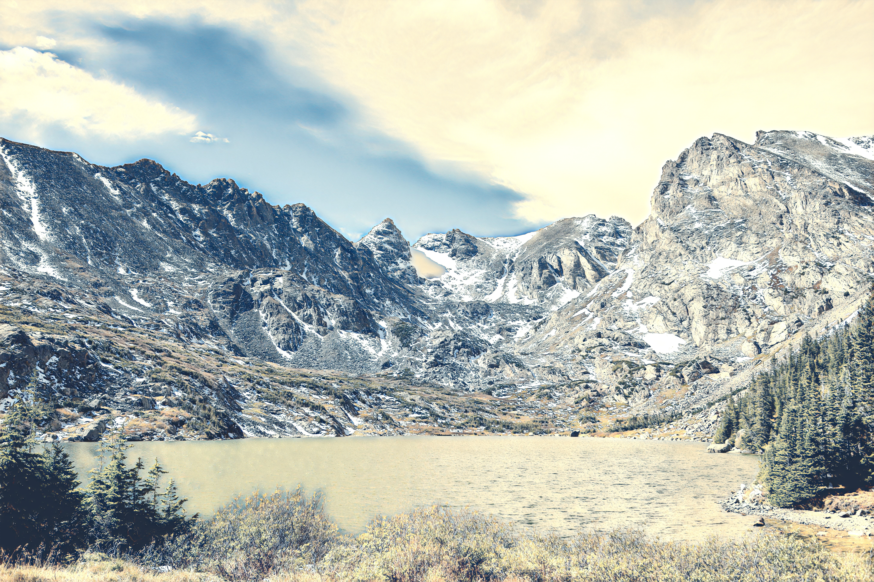
Analysis - Feature Sizes
Style Transfer Results:

Slide 21
Analysis - Training History

